Slide 1
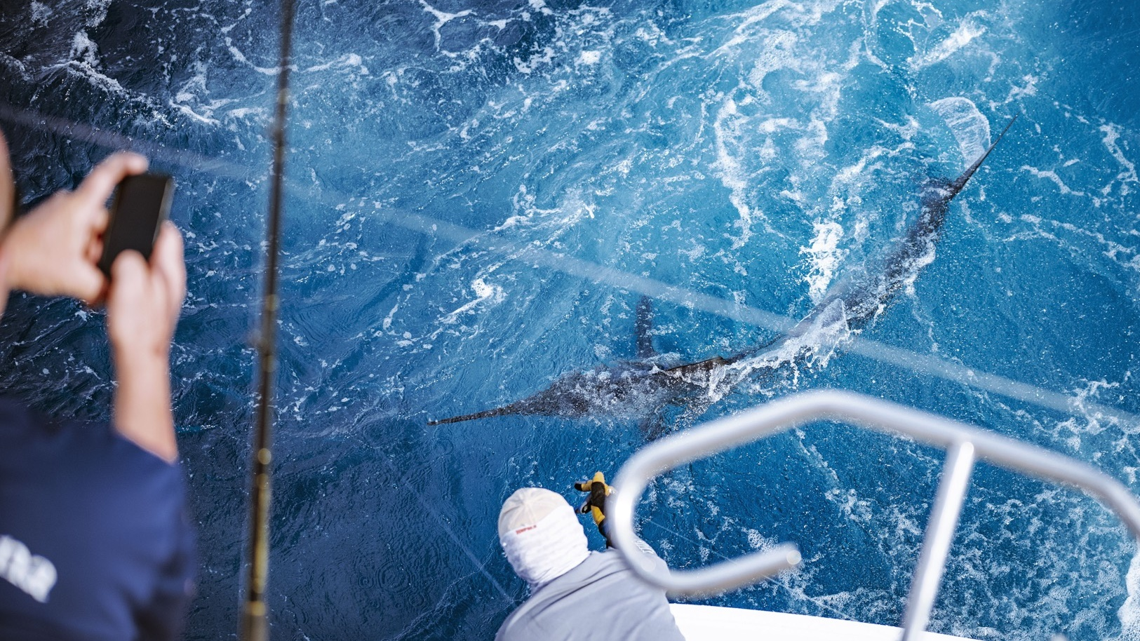
RODS

Slide 2
NEW
Blank de carbono
Anillas en espiral
Increible backbone (columna)
Anillas super resistentes Sea Guide
Protector de cruceta
Empuñadura delantera de combate Empuñadura trasera deslizante Porta carrete de aluminio Cruceta de aluminio MSRP €189,90
CODE​ | ITEM​ | PC​ | CM​
WT59XH | Typhoon Stand Up 50-80 lbs 5'9" | 1​+1 | 175
WT60H | Typhoon Stand Up 30-50 lbs 6' | 1+1 | 183​
WT69M | Typhoon Stand Up 20-30 lbs 5'9" | 1+1 | 206
WT611L | Typhoon Stand Up 12-20 lbs 6'11" | 1​+1 | 211

Slide 3
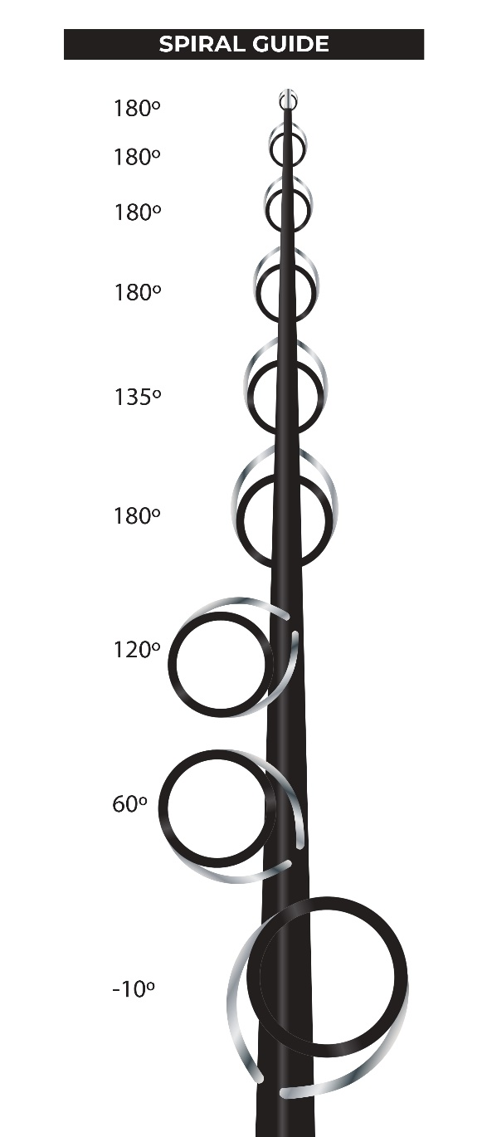
Tech concepts

Slide 4
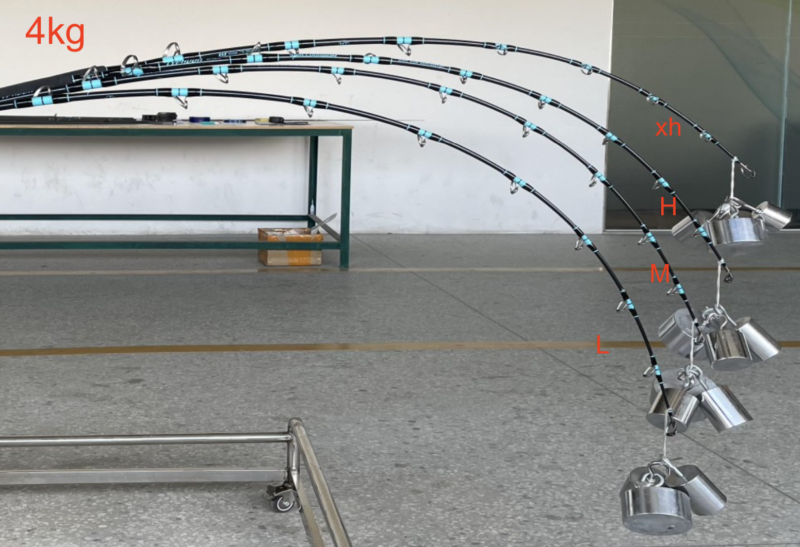
Breaking test
WT611L 23,2 kg
WT69M 32,7 kg
WT60H 36,8 kg
WT59XH 46 kg

Slide 5
LINK TO VIDEO

